Slide 1
The web, under the hood
By Shahbaz Chaudhary

Slide 2

What happens when you visit a website?

Slide 3



The browser appends a port number: 80
http://uchicago.edu:80

Slide 4

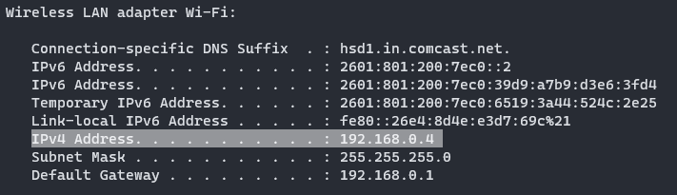
Detour: ports and IP addresses (simplified)
Each computer on a network has a unique IP address. The internet is made up of many networks. Get your current address by using the ifconfig (or ipconfig) command.
A machine may be running many servers: web server, time server, ssh server, etc.
How do we differentiate among services?
Using ports!
http (web): port 80
ssh: port 22
ntp (network time protocol): port 123
68.45.56.20

Slide 5
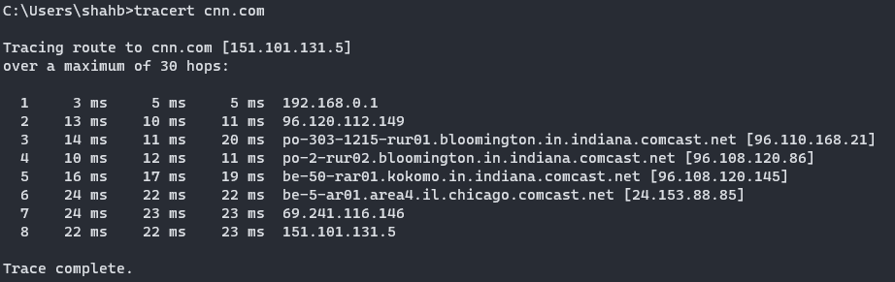
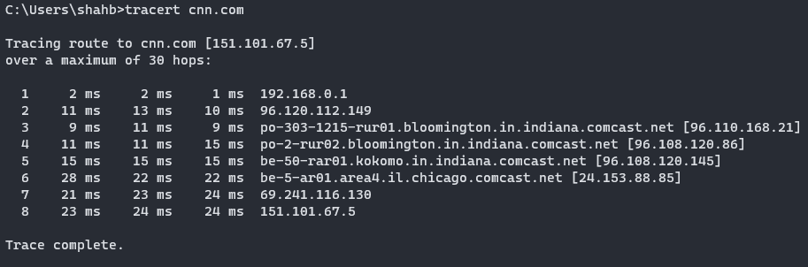
Modern internet uses packets while old phone network was a very long cable
Notice that data going from your computer to a remote server can take different paths (tracert or traceroute)
The ability to take different routes means the network is route around damaged nodes.
Makes sense, since the original network was designed to survive nuclear war!
Pro-tip: check if a machine is down by doing ping machine_ip

Slide 6
HTML, CSS and JavaScript

Slide 7

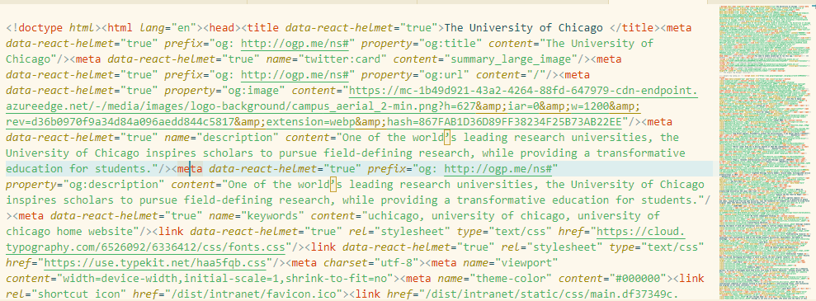
What exactly is a web page?
Try “View page source” or open developer tools to get a peek at the code

Slide 8
HTML (Hyper text markup language) contains the content of a web page
<html>
<head>
<link rel="stylesheet" href="css/layout.css" type="text/css">
<script type="text/javascript" src="script.js"></script>
</head>
<body>
<p> This is a paragraph. It can contain a block of text and can
contain multiple lines </p> HTML can contain <a href="http://uchicago.edu"> links </a>.
</body>
</html>
HTML is a markup language, not a full language like Python or Javascript. (This is not a value judgement)

Slide 9
CSS (Cascading Style Sheets) controls the look & feel (and behavior) of HTML
/* https://www.w3schools.com/css/ */
body {
background-color: lightblue;
}
h1 {
color: white;
text-align: center;
}
p {
font-family: verdana;
font-size: 20px;
}
Web developers often let the designers work with CSS. Non-designers, such as myself, often use CSS frameworks, such as Bootstrap or Tailwind.
See developer tools for a full list of CSS properties

Slide 10
Javascript is the official programming language of the web (and the only one*)
//https://www.w3schools.com/jsref/event_onclick.asp
<h3 id="demo" onclick="myFunction()">Click me to change my color.</h3>
<script>
function myFunction() {
document.getElementById("demo").style.color = "red";
}
</script>
* Newer technologies such as WASM will allow more and more languages to be available

Slide 11
There are convenient online tools to test http + css + js
https://jsfiddle.net/
https://jsbin.com/?html,output

Slide 12
Web pages can be dynamically generated
from datetime import datetime
def hello_world():
return f"<p>Current time:{datetime.now().strftime("%H:%M")}</p>“
if __name__ == '__main__’:
print(hello_world())
Python
Printed to console
<p>Current time: 2:11</p>

Slide 13

Web pages can be dynamically generated
from datetime import datetime
from flask import Flask
app = Flask(__name__)
@app.route("/")
def hello_world():
return f"<p>Current time:{datetime.now().strftime("%H:%M")}</p>“
Python
(server side)
Generated HTML
(server side)
<p>Current time: 2:11</p>
Browser view
(client side)
Current time: 2:11

Slide 14
Web URLs contain lots of information
protocol (http or https)
http://somewebsite.com
site address
route
http://somewebsite.com/section_a/item_c
parameter names and values
http://somewebsite.com/section_a/item_c?param_a=val1&param_b=val2

Slide 15
Hands on keyboard …

Slide 16
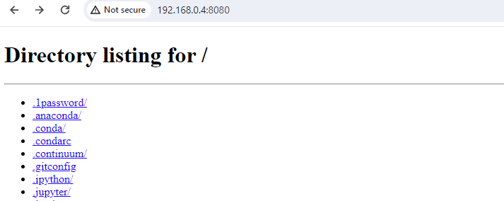
Run your own web server python –m http.server 8080
What url can you type in your browser to view your local “web site?”
Get the assigned IP using ipconfig or ifconfig
Visit that url in the browser (remember to add the port)
Connection-specific DNS Suffix . : hsd1.in.comcast.net.
IPv6 Address. . . . . . . . . . . : 2601:801:200:7ec0::2
IPv6 Address. . . . . . . . . . . : 2601:801:200:7ec0:39d9:a7b9:d3e6:3fd4
Temporary IPv6 Address. . . . . . : 2601:801:200:7ec0:6519:3a44:524c:2e25
Link-local IPv6 Address . . . . . : fe80::26e4:8d4e:e3d7:69c%21
IPv4 Address. . . . . . . . . . . : 192.168.0.4
Subnet Mask . . . . . . . . . . . : 255.255.255.0
Default Gateway . . . . . . . . . : 192.168.0.1

Slide 17
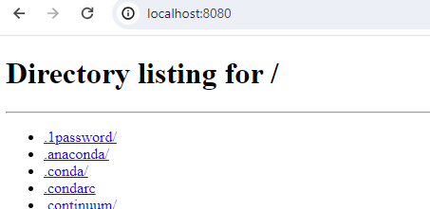
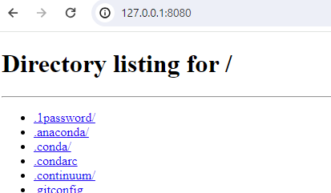
Just use special names: 127.0.0.1 or localhost

Slide 18
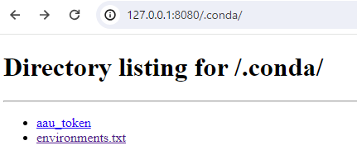
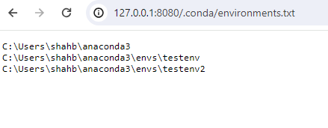
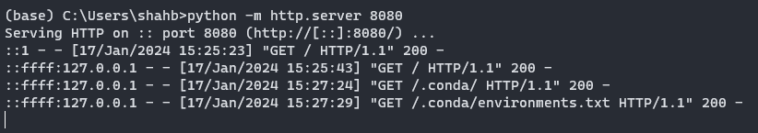
Look at the server logs
Each time the browser asks for more information, the server displays the log for it
The server prints the
- IP address (of the client)
- the date and time
- “GET”
- the route
- “HTTP/1.1”
- 200

Slide 19

Look at the server logs
Each time the browser asks for more information, the server displays the log for it
The server prints the
- IP address (of the client)
- the date and time
- “GET”
- the route
- “HTTP/1.1”
- 200
What happens if you try http://localhost:8080/blahblahblah

Slide 20
HTTP protocol

Slide 21
Web log contents
::ffff:127.0.0.1 - - [17/Jan/2024 15:25:43] "GET / HTTP/1.1" 200 -
::ffff:127.0.0.1 - - [17/Jan/2024 15:27:24] "GET /.conda/ HTTP/1.1" 200 -
::ffff:127.0.0.1 - - [17/Jan/2024 15:27:29] "GET /.conda/environments.txt HTTP/1.1" 200 -
GET
The HTTP protocol defines some methods, such as GET, POST, PUT, DELETE. GET translates to “read a resources at the given route”
/.conda/environments.txt
This is the route and the resource requested by the browser
HTTP/1.1
The HTTP protocol version specifics generally are negotiated by the browser and the server and are of little concern to developers
200
Each request from the browser results in a response from the server, along with a response code. 200 means everything is ok. Do you know the code for a resource which isn’t found? 404!

Slide 22
What is exchanged between your browser and the server?
Open a network connection (provides IP to the server)
Server
Browser
HTTP GET request for a route
HTTP response header
HTTP response content

Slide 23
What is exchanged between your browser and the server?
1. Browser request
2. Server response header
GET /.conda/ HTTP/1.1
Accept: text/html,application/xhtml+xml,application/xml;q=0.9,image/avif,image/webp,image/apng,*/*;q=0.8,application/signed-exchange;v=b3;q=0.7
Accept-Encoding: gzip, deflate, br
Accept-Language: en-US,en;q=0.9
Cache-Control: max-age=0
Connection: keep-alive
Host: 127.0.0.1:8080
Referer: http://127.0.0.1:8080/
Sec-Fetch-Dest: document
Sec-Fetch-Mode: navigate
Sec-Fetch-Site: same-origin
Sec-Fetch-User: ?1
Upgrade-Insecure-Requests: 1
User-Agent: Mozilla/5.0 (Windows NT 10.0; Win64; x64) AppleWebKit/537.36 (KHTML, like Gecko) Chrome/120.0.0.0 Safari/537.36
sec-ch-ua: "Not_A Brand";v="8", "Chromium";v="120", "Google Chrome";v="120"
sec-ch-ua-mobile: ?0
sec-ch-ua-platform: "Windows"
HTTP/1.0 200 OK
Server: SimpleHTTP/0.6 Python/3.11.5
Date: Wed, 17 Jan 2024 21:45:21 GMT
Content-type: text/html; charset=utf-8
Content-Length: 301
3. Server response body
<!DOCTYPE HTML>
<html lang="en">
<head>
<meta charset="utf-8">
<title>Directory listing for /.conda/</title>
</head>
<body>
<h1>Directory listing for /.conda/</h1>
<hr>
<ul>
<li><a href="aau_token">aau_token</a></li>
<li><a href="environments.txt">environments.txt</a></li>
</ul>
<hr>
</body>
</html>

Slide 24
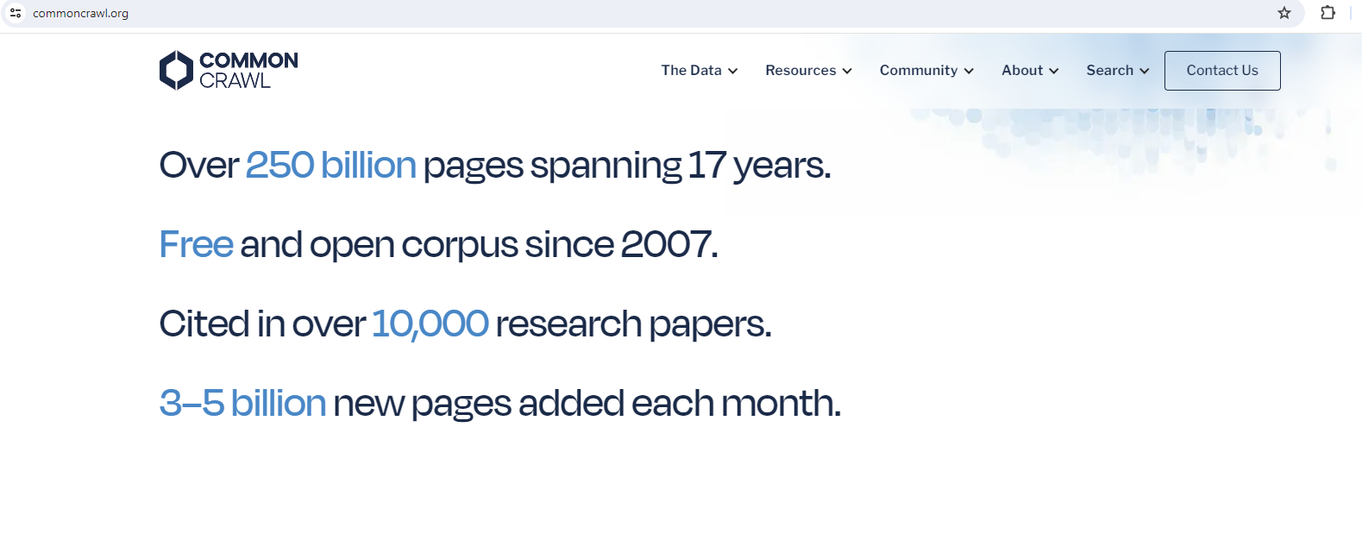
BTW: Common Crawl provides billions of web pages and the request/response headers

Slide 25
A closer look at an HTTP request Browser to the server
GET /.conda/ HTTP/1.1
Accept: text/html,application/xhtml+xml,application/xml;q=0.9,image/avif,image/webp,image/apng,*/*;q=0.8,application/signed-exchange;v=b3;q=0.7
Accept-Encoding: gzip, deflate, br
Accept-Language: en-US,en;q=0.9
Cache-Control: max-age=0
Connection: keep-alive
Host: 127.0.0.1:8080
Referer: http://127.0.0.1:8080/
Sec-Fetch-Dest: document
Sec-Fetch-Mode: navigate
Sec-Fetch-Site: same-origin
Sec-Fetch-User: ?1
Upgrade-Insecure-Requests: 1
User-Agent: Mozilla/5.0 (Windows NT 10.0; Win64; x64) AppleWebKit/537.36 (KHTML, like Gecko) Chrome/120.0.0.0 Safari/537.36
sec-ch-ua: "Not_A Brand";v="8", "Chromium";v="120", "Google Chrome";v="120"
sec-ch-ua-mobile: ?0
sec-ch-ua-platform: "Windows"

Slide 26
A closer look at the HTTP response Server to the browser
Header
Body
HTTP/1.0 200 OK
Server: SimpleHTTP/0.6 Python/3.11.5
Date: Wed, 17 Jan 2024 21:45:21 GMT
Content-type: text/html; charset=utf-8
Content-Length: 301
<!DOCTYPE HTML>
<html lang="en">
<head>
<meta charset="utf-8">
<title>Directory listing for /.conda/</title>
</head>
<body>
<h1>Directory listing for /.conda/</h1>
<hr>
<ul>
<li><a href="aau_token">aau_token</a></li>
<li><a href="environments.txt">environments.txt</a></li>
</ul>
<hr>
</body>
</html>

Slide 27
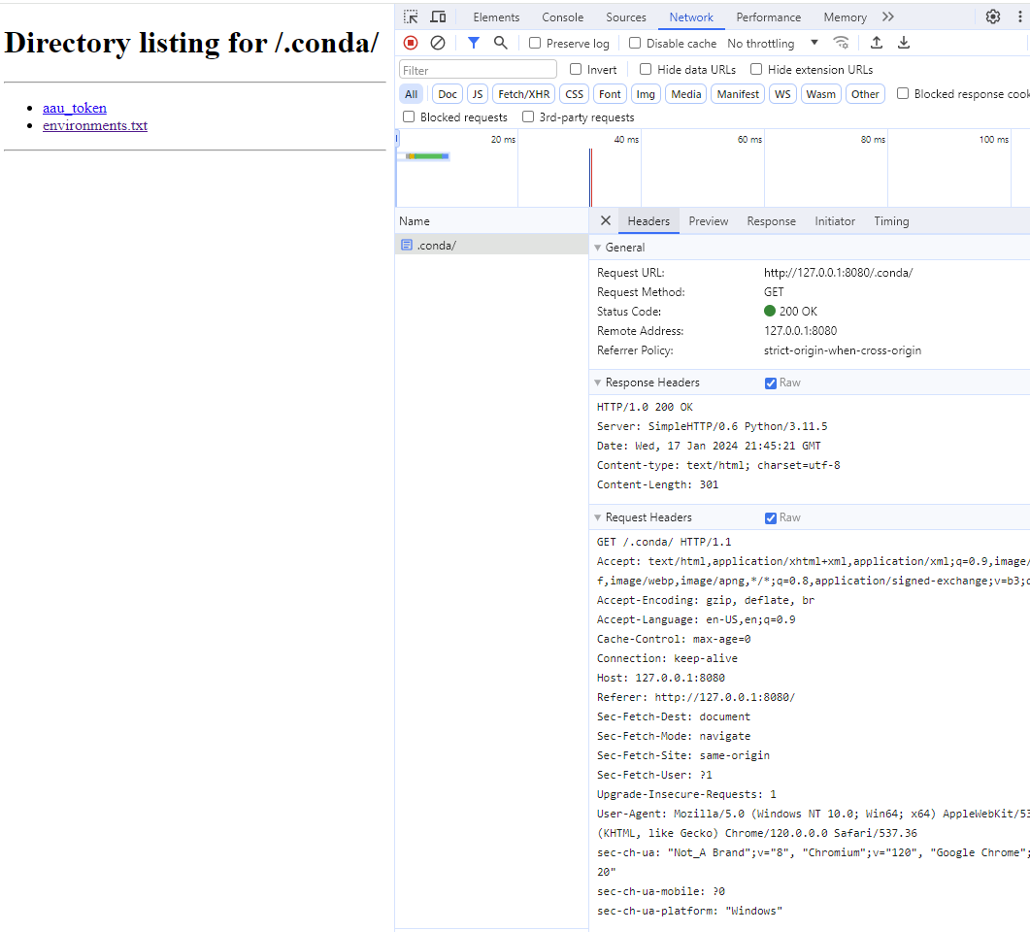
What is exchanged between your browser and the server?
The HTTP protocol is a text based protocol. It is easy to parse, easy to debug and easy to wrap in libraries of any language.
This means there are thousands of libraries and tools which “speak” http.

Slide 28
Closer look at HTTP methods
::ffff:127.0.0.1 - - [17/Jan/2024 15:25:43] "GET / HTTP/1.1" 200 -
::ffff:127.0.0.1 - - [17/Jan/2024 15:27:24] "GET /.conda/ HTTP/1.1" 200 -
::ffff:127.0.0.1 - - [17/Jan/2024 15:27:29] "GET /.conda/environments.txt HTTP/1.1" 200 -
GET
The HTTP protocol defines some methods, such as GET, POST, PUT, DELETE. GET translates to “read a resources at the given route”
The http protocol provides four methods
Method | CRUD | Web developer description | Data scientist description
POST | Create | Create new resource | Can submit data, such as inputs to a model
GET | Read | Retrieves web pages at a given route | Normal web request
PUT | Update | Update a resource | Not relevant
DELETE | Delete | Remove a resource | Not relevant

Slide 29
HTTP methods: GET and POST
We have seen that GET is the same as a standard web request
http://somewebsite.com/section_a/item_b?param1=value&param2=value
If we are building a prediction service, the inputs to the model can just be the arguments param1 and param2?
A more generally accepted method is to use POST. POST allows clients to submit a JSON* object as a “payload,” along with the url.
http://somewebsite.com/section_a/item_b
{param1:value, param2:value}
Parameters encoded in the URL, as with GET, have space limits and often need to encode special characters. POST removes such limitations.
*POST is not limited to JSON, it can be any data

Slide 30
HTTP libraries

Slide 31
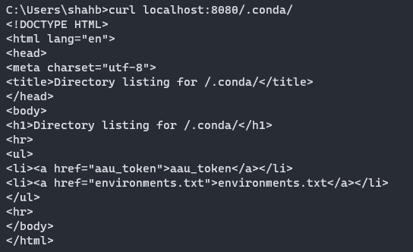
Practically every language has libraries for writing http clients and servers
You can even use the command line to access a simple http resource:
curl http://127.0.0.1:8080/.conda/
Warning: windows and mac/linux have tools called curl, but they seem to be slightly different

Slide 32
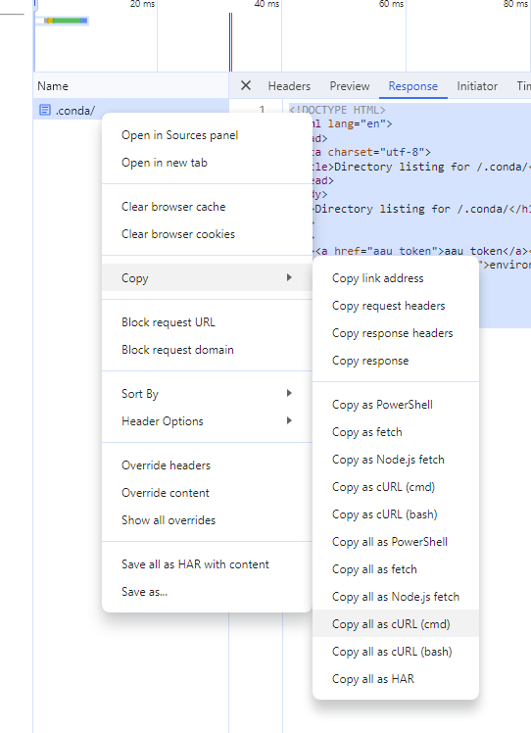
Practically every language has libraries for writing http clients and servers
You can even use the command line to access a not so simple http resource:
curl "http://127.0.0.1:8080/.conda/" ^
-H "Accept: text/html,application/xhtml+xml,application/xml;q=0.9,image/avif,image/webp,image/apng,*/*;q=0.8,application/signed-exchange;v=b3;q=0.7" ^
-H "Accept-Language: en-US,en;q=0.9" ^
-H "Cache-Control: max-age=0" ^
-H "Connection: keep-alive" ^
-H "Referer: http://127.0.0.1:8080/" ^
-H "Sec-Fetch-Dest: document" ^
-H "Sec-Fetch-Mode: navigate" ^
-H "Sec-Fetch-Site: same-origin" ^
-H "Sec-Fetch-User: ?1" ^
-H "Upgrade-Insecure-Requests: 1" ^
-H "User-Agent: Mozilla/5.0 (Windows NT 10.0; Win64; x64) AppleWebKit/537.36 (KHTML, like Gecko) Chrome/120.0.0.0 Safari/537.36" ^
-H "sec-ch-ua: ^\^"Not_A Brand^\^";v=^\^"8^\^", ^\^"Chromium^\^";v=^\^"120^\^", ^\^"Google Chrome^\^";v=^\^"120^\^"" ^
-H "sec-ch-ua-mobile: ?0" ^
-H "sec-ch-ua-platform: ^\^"Windows^\^"" ^
--compressed

Slide 33
cURL is an extremely versatile tool
Normal GET request
curl http://somewebsite.com/some_resource
POST request with a JSON payload
curl –X POST \
–H “Content-Type: application/json” \
–d “{param1:val, param2:val}” http://somewebsite.com/some_resource
Warning: windows and mac/linux have tools called curl, but they seem to be slightly different

Slide 34
Web services

Slide 35
If HTTP is supported by every language, every operating system, many browsers, even the command line, isn’t it also a great tool to exchange data?
That’s what web services are!

Slide 36

Web services: serve data, instead of web pages (… but text?)
#serve text
from datetime import datetime
from fastapi import FastAPI
app = FastAPI
@app.get('/status')
def status():
return "OK"
@app.get('/get_time')
def get_time():
t = f'current time is {datetime.now().strftime("%H:%M")}'
return t
# fastapi dev serve_text.py –host 0.0.0.0
# curl http://127.0.0.1:8000/get_time

Slide 37
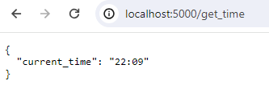
Web services: serve JSON
#serve json
from datetime import datetime
from fastapi import FastAPI
app = FastAPI()
@app.get('/status')
def status():
d = {'status': 'OK'}
return d
@app.get('/get_time')
def get_time():
d = {'current_time':datetime.now().strftime("%H:%M")}
return d
# fastapi dev serve_json.py

Slide 38
BTW: “JSON” is a simple data format
From: https://www.json.org/json-en.html
JSON (JavaScript Object Notation) is a lightweight data-interchange format. It is easy for humans to read and write. It is easy for machines to parse and generate. It is based on a subset of the JavaScript Programming Language ...
JSON is built on two structures:
A collection of name/value pairs. In various languages, this is realized as an object, record, struct, dictionary, hash table, keyed list, or associative array.
An ordered list of values. In most languages, this is realized as an array, vector, list, or sequence.
These are universal data structures. Virtually all modern programming languages support them in one form or another. It makes sense that a data format that is interchangeable with programming languages also be based on these structures.
{
name: “Homer Simpson”,
age: 38,
is_married: true,
friends: [“Lenny”, “Carl”],
children: {“Bart”: 10,
“Lisa”: 8,
“Maggie”:1}
}

Slide 39
BTW: “JSON” is a simple data format
Recall that HTTP is text based, easy for humans to read and for computers to parse, but not necessarily the most efficient. HTTP is a transport protocol.
Similarly
JSON is also text based, easy for humans to read (and type) and for computer to parse, but definitely not the most efficient. JSON is a data representation or data interchange format.
{
name: “Homer Simpson”,
age: 38,
is_married: true,
friends: [“Lenny”, “Carl”],
children: {“Bart”: 10,
“Lisa”: 8,
“Maggie”:1}
}

Slide 40
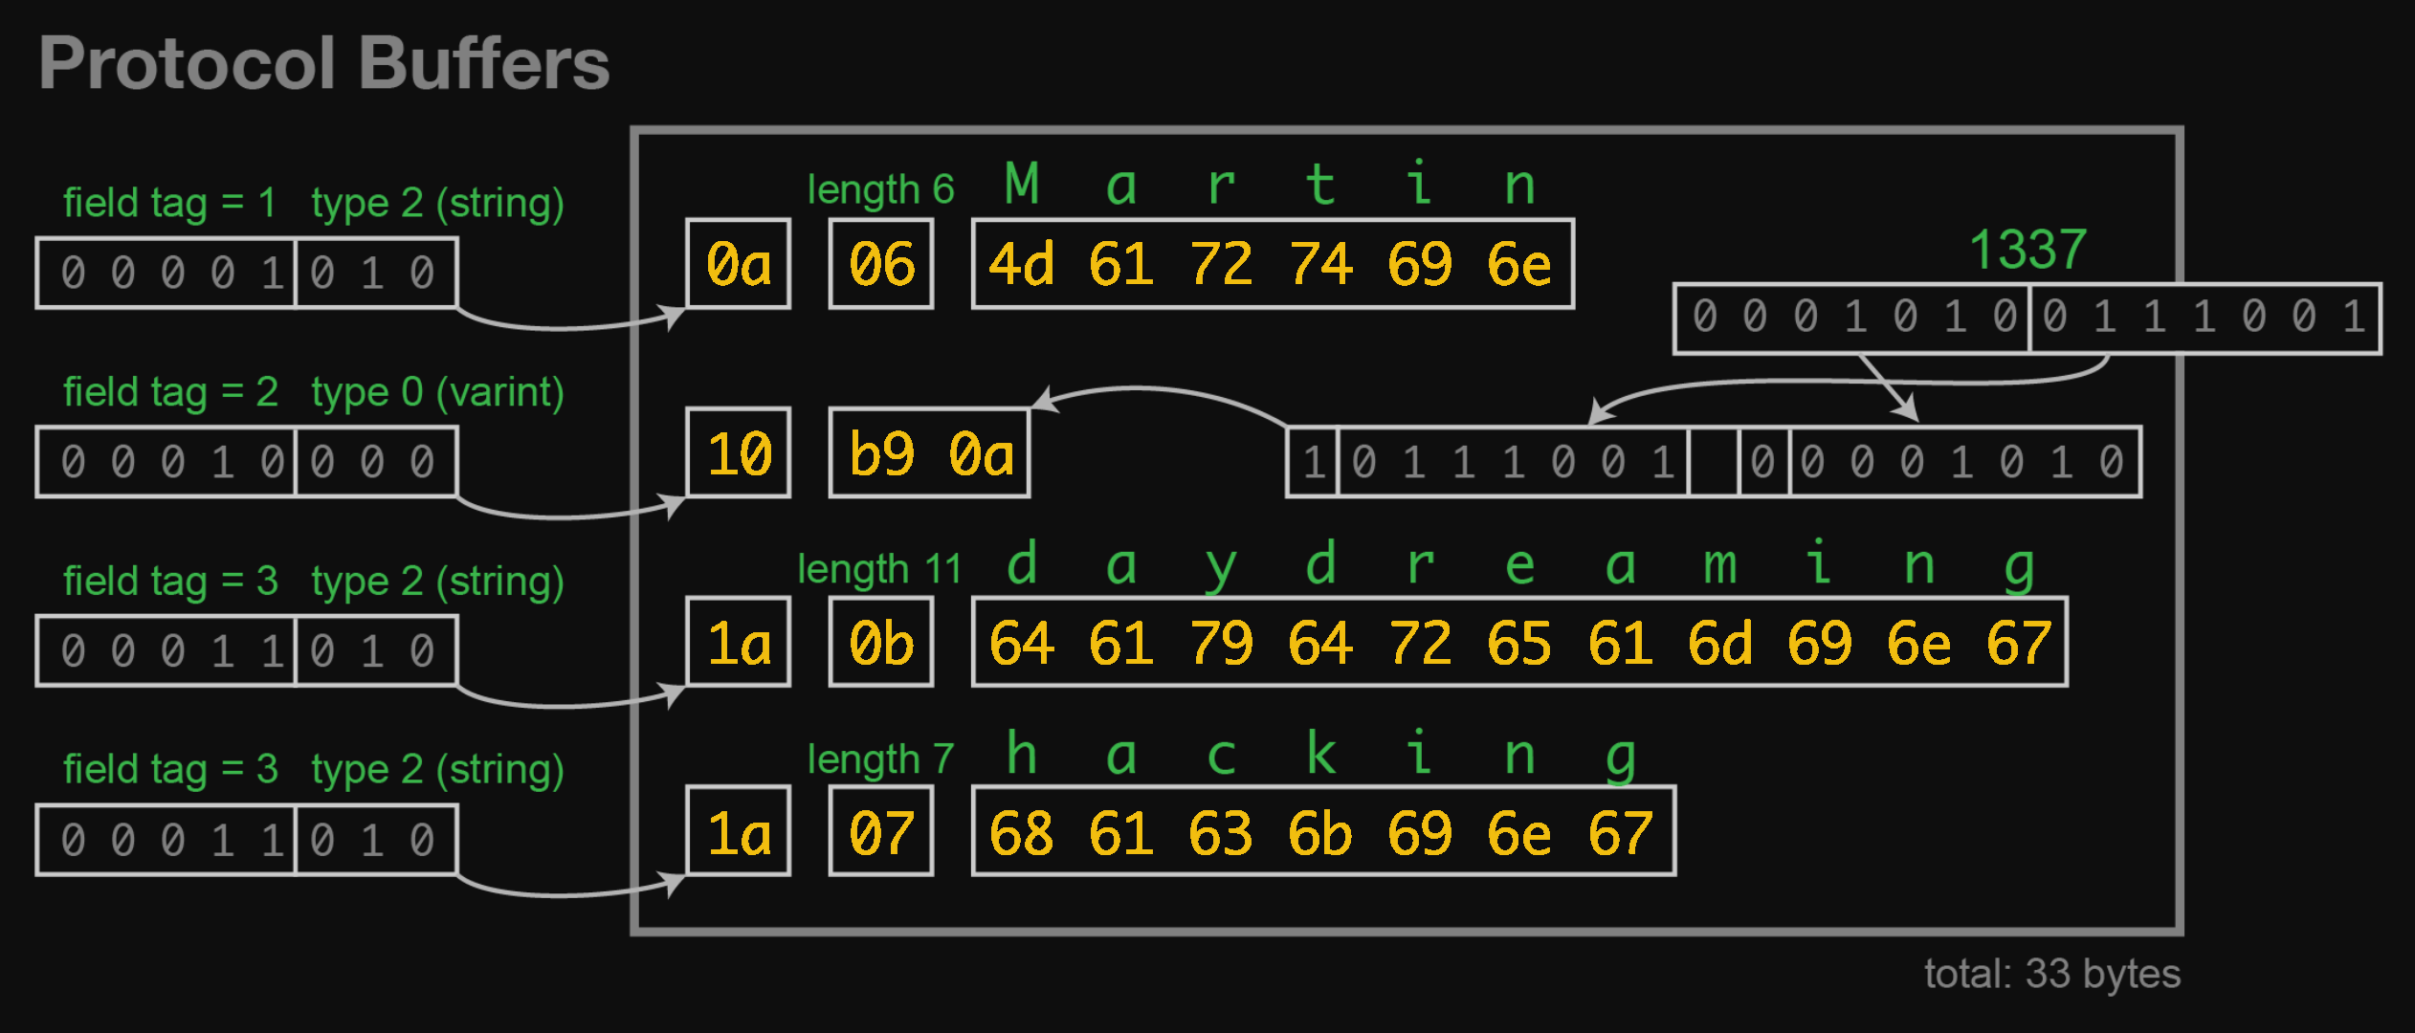
BTW: “JSON” is a simple data format
Here is an example from Martin Kleppman, showing the format of a binary protocol (Protobufs, in this case)
{
name: “Homer Simpson”,
age: 38,
is_married: true,
friends: [“Lenny”, “Carl”],
children: {“Bart”: 10,
“Lisa”: 8,
“Maggie”:1}
}
https://hackaday.com/2020/06/10/the-ceedy-world-of-message-serialization/martin-kleppmann-protocol-buffers-themed/

Slide 41
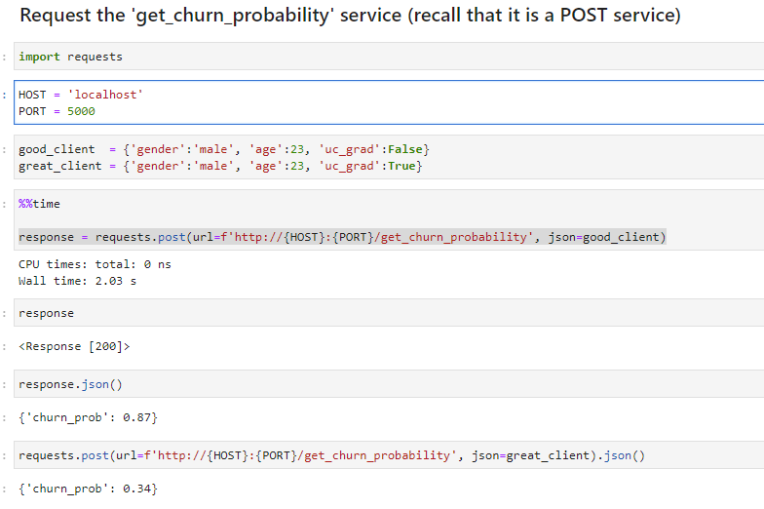
A web services system produces and consumes JSON over HTTP
#serve post json
from datetime import datetime
from fastapi import FastAPI
app = FastAPI()
@app.get('/get_time’)
...
class ClientData(BaseModel):
gender: str
age: int
uc_grad: bool
@app.post('/get_churn_probability')
def get_churn_probability(client_props: ClientData):
#if 'UC_GRAD' not in client_properties:
# pass throw error
# Our churn model is fake, we don't actually use an ML model :(
if client_props.uc_grad == "true":
return {'churn_prob':0.34}
else:
return {'churn_prob':0.87}
# fastapi dev serve_post_json.py
See notebook 075_web_services_under_the_hood/consume_services.ipynb

Slide 42
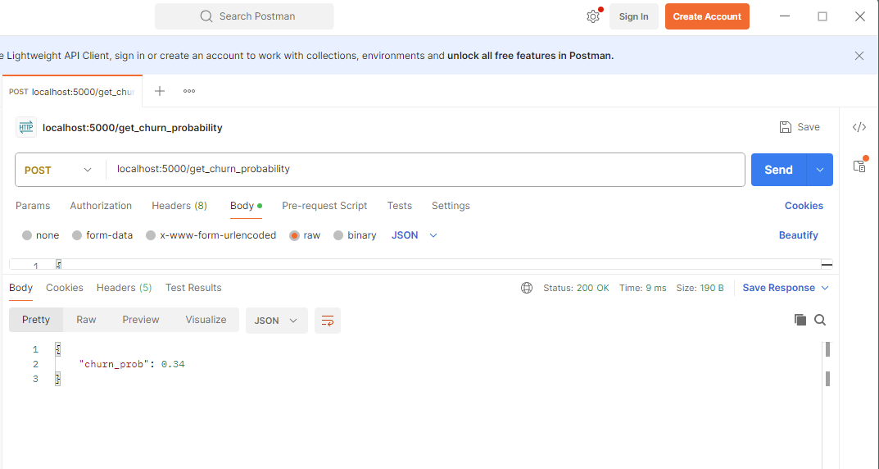
Testing web services without writing Python code
Windows (Power Shell)
Invoke-RestMethod -Uri http://localhost:5000/get_churn_probability -Method Post -Headers @{"Content-Type"="application/json"} -Body '{"gender": "male", "age": 23, "uc_grad":"False"}’
Mac/Linux
curl -X POST http://localhost:5000/get_churn_probability -H "Content-Type: application/json" -d '{"gender": "male", "age": 23, "uc_grad":"False"}'
Postman (https://www.postman.com/) is a great and often used GUI tool to test web services. Basic version is free

Slide 43
Btw … try …/docs

Slide 44
In-class exercise
Please write a small service which uses a POST method to accept two numbers, add them and return the result.
You should accept a JSON object like this: {num1:2, num2:3}
Be prepared to share your IP (ifconfig/ipconfig) and port with me so I (and others) can test your service.
Mac users:
curl -X POST http://localhost:5000/get_num -H "Content-Type: application/json" -d '{"x": 5, "y": 5}’
Windows (Power Shell) users:
Invoke-RestMethod -Uri http://localhost:5000/get_num -Method Post -Headers @{"Content-Type"="application/json"} -Body '{"x": 5, "y": 5}'

Slide 45
Easy UI for your web services
Streamlit or Gradio or Panel or Viola or
pip install streamlit

Slide 46
As data scientists, we use tools to generate HTML pages, such as: streamlit
1
Create streamlit_app.py
2
Edit it
import streamlit as st
st.write("Hello")
3
Run it
streamlit run streamlit_app.py
You can now view your Streamlit app in your browser.
Local URL: http://localhost:8501
Network URL: http://192.168.0.4:8501

Slide 47
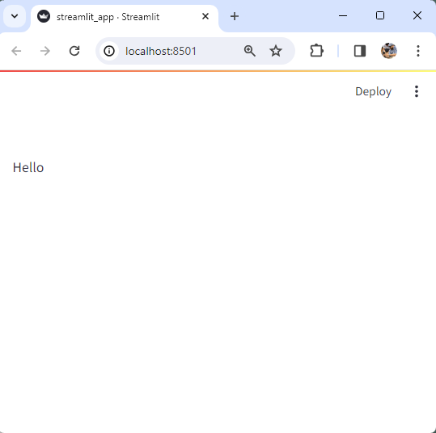
streamlit translates Python to HTML, reactively
import streamlit as st
st.write("Hello")

Slide 48
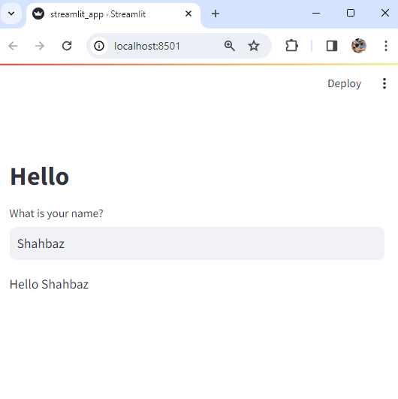
streamlit translates Python to HTML, reactively
import streamlit as st
st.markdown("# Hello")
name = st.text_input("What is your name?")
st.write(f"Hello {name}")

Slide 49
Code is not just executed linearly
import streamlit as st
st.markdown("# Hello")
name = st.text_input("What is your name?")
st.write(f"Hello {name}")
Notice how these variables are updated automatically?

Slide 50
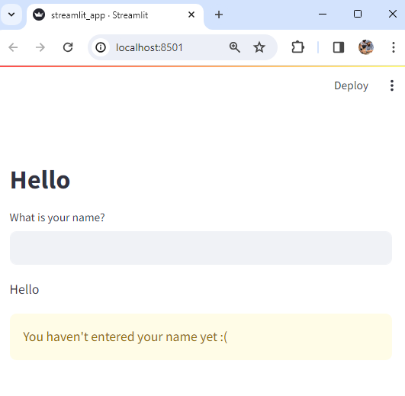
All code is executed, each time a variable changes (“reactive”)
import streamlit as st
st.markdown("# Hello")
name = st.text_input("What is your name?")
st.write(f"Hello {name}")
if len(name.strip()) == 0:
st.warning("You haven't entered your name yet :(")

Slide 51
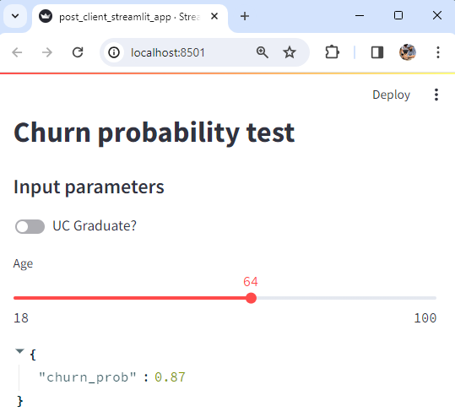
Build an interface to your web service See slide 36
import requests
import streamlit as st
st.markdown("# Churn probability test")
st.markdown("#### Input parameters")
uc_grad = st.toggle("UC Graduate?")
age = st.slider("Age", 18, 100)
response = requests.post(url=f"http://localhost:5000/get_churn_probability", json = {'gender':'male', 'age':age, 'uc_grad':uc_grad})
st.write(response.json())

Slide 52
See steramlit.io docs for a complete list of widgets
https://docs.streamlit.io/library/api-reference

Slide 53
Appendix

Slide 54
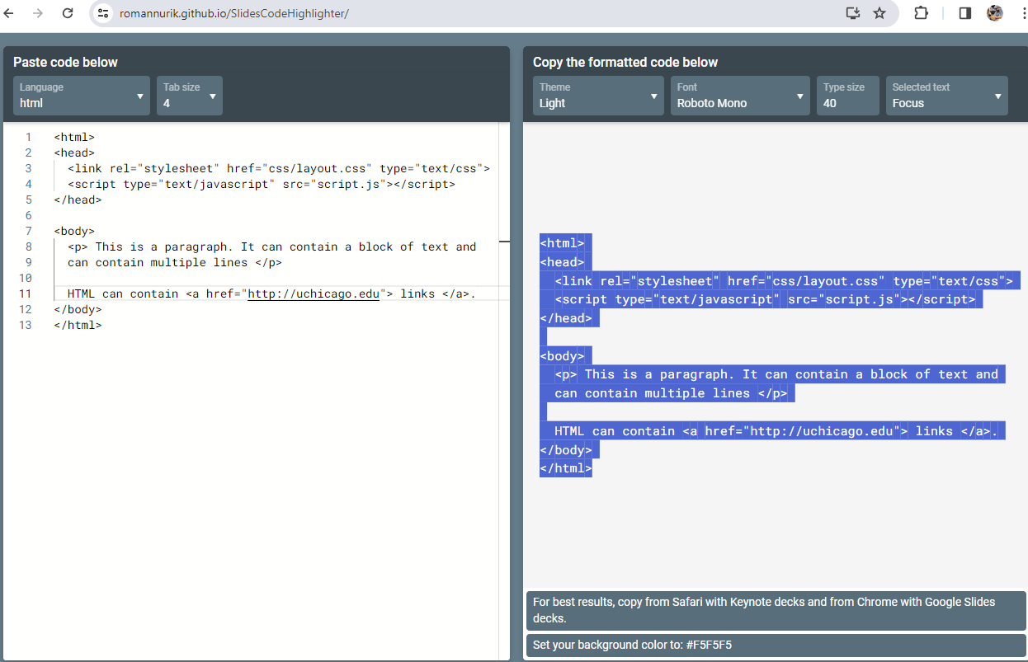
Syntax highlighting
Theme used for code snippets:
VS Code’s “Monokai Light” by Velichko Konstantin

